Slide 1
Notebook layout Anibal used

Slide 2
Folders
root
--data (for raw files)
--data_pickled (for cached in-memory object)
--scripts (for .py script/module files)
--experiments (for .ipynb files)
--shared (shared libraries developed in .ipynb format or shared data source loader )
--config (yaml/json config)

Slide 3
Steps to write a notebook easy to share
My suggestion:
Manage the source code in the scripts and shared folder by the whole team and every function and type definition should be reviewed, and artifacts of everyone should be successfully executed in the experiments folder. This should be forced or there would be several magic (dirty/ugly?) code snippets around the world (of the team)

Slide 4
Experiments library loading
1. cd twice (to change directory to root)
2. processing arguments (better to use argparse etc.)
import sys
import re
if re.search("ip", sys.argv[1]) is None: #vscode with jupyter extension
#process argv here for vscode execution
else:
#process argv here for none vscode execution

Slide 5
Experiments library loading
3. %run "shared\load_func_from_root.ipynb“
I use load_func_from_root.ipynb to load notebooks if I am not debugging the shared notebooks. (in contrast, I use load_func_local.ipynb)

Slide 6
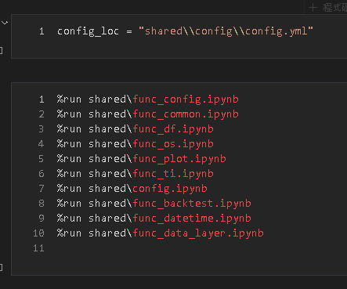
load_func_from_root.ipynb

Slide 7
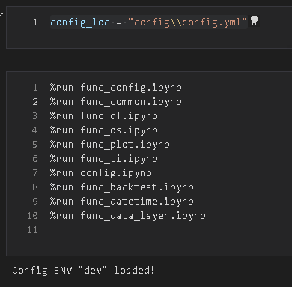
load_func_local.ipynb

Slide 8
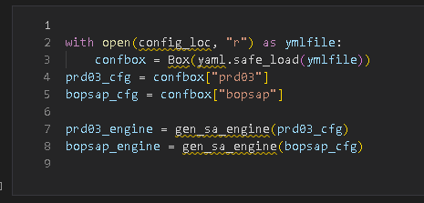
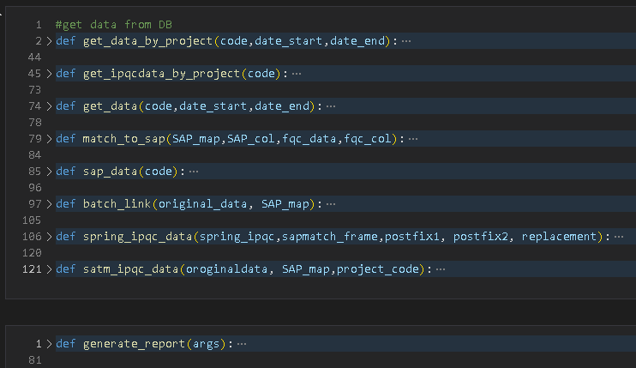
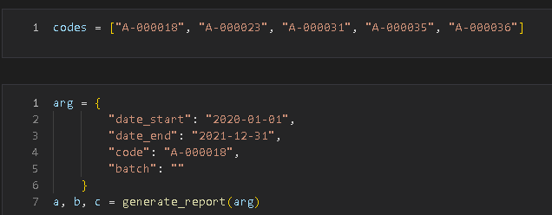
Data Processing
(Depends on ETL or ELT process)
Anyway E(extraction) always first
Step 4. run shared data source loader or Ad Hoc query

Slide 9
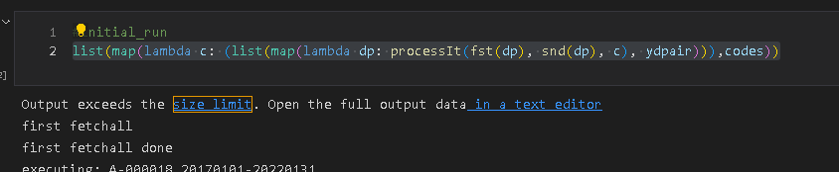
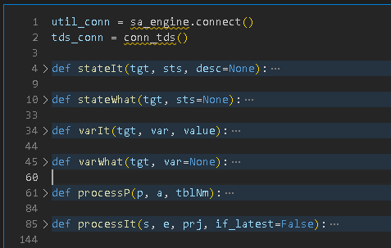
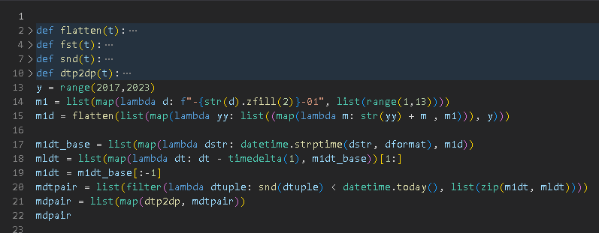
Data Processing
Step 5. Transformation → Load into destination
(process with Python first and insert)

Slide 10
Data Processing
Step 5. Load into destination → Transformation
(insert directly and process with SQL) (or node.js if the destination is a MongoDB)

Slide 11
Scheduler
So far I am using SQL Server Agent in 192.168.7.102
https://learn.microsoft.com/en-us/sql/ssms/agent/schedule-a-job?view=sql-server-ver16

Slide 12
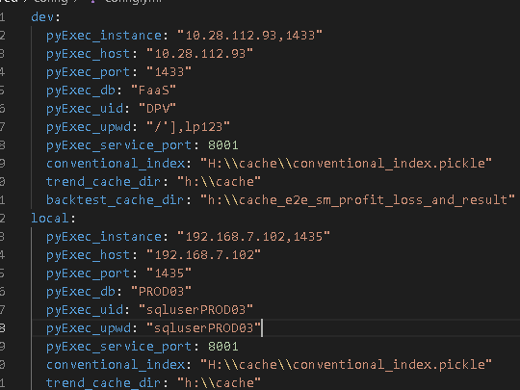
Config

Slide 13
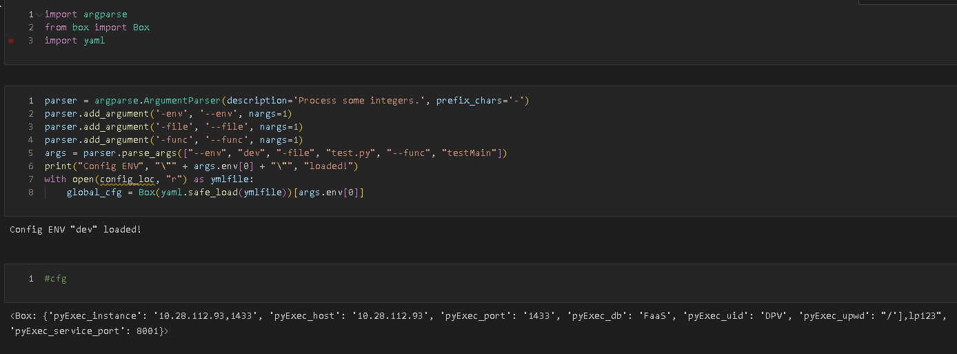
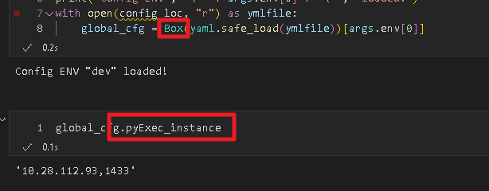
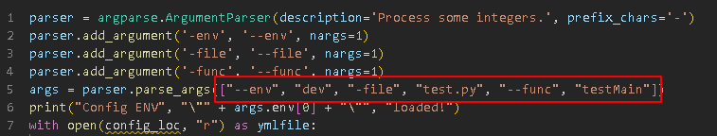
We can change the list value to choose the section we want

